Slide 1
Object detection in Point Cloud: pole
——Zhenyuan Du
Xinghang Ma

Slide 2
Introduction
Using this method we can create and update accurate maps and spatial databases.
we use these applications such as city management, urban planning, and intelligent transportation systems.
For city management and urban planning, accurate land cover information is needed to document cities growth,
make policy decisions, and improve land use planning

Slide 3
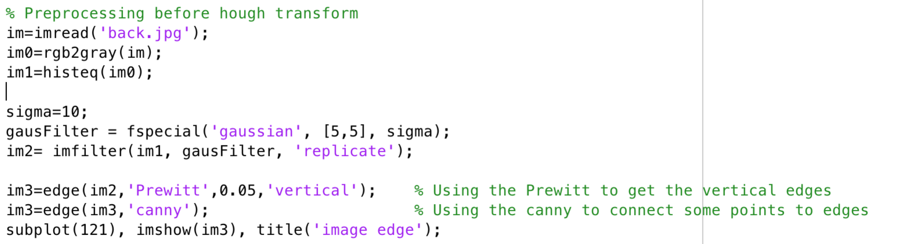
Approach
Step1
This part is the preprocessing which use Gaussian filter to remove the noise points from gray image before Hough Transform. And it uses Prewitt to detect the vertical edges and Canny to connect close points.

Slide 4
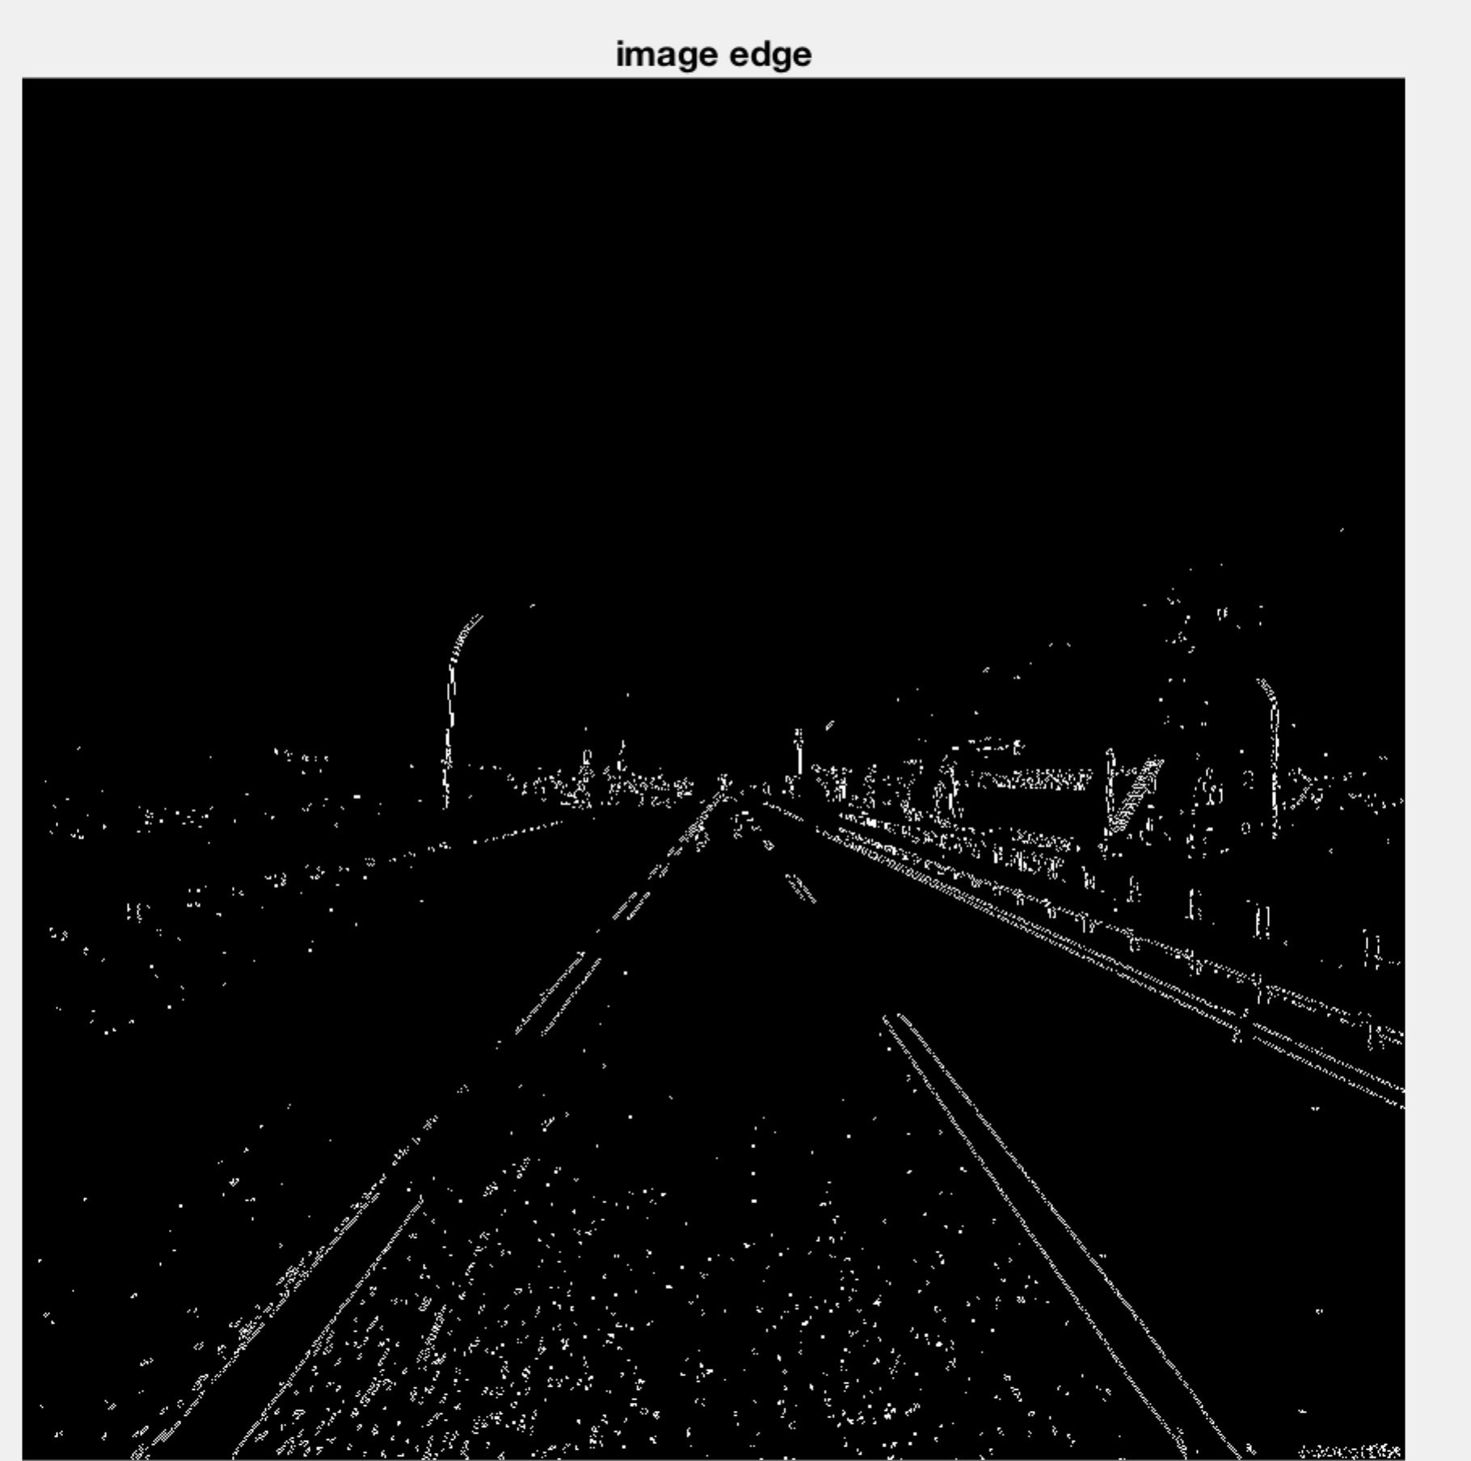
Result
Step1

Slide 5
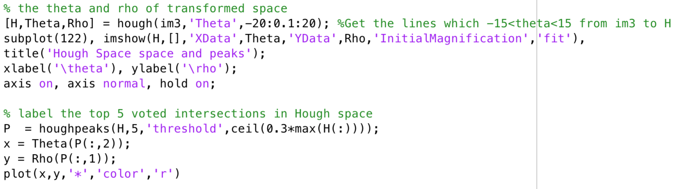
Approach
Step2
In this step,we use the Hough transform to get the specific lines whose Theta are in range of [-15,15]. And we label the 5 most voted intersections in Hough space with red color.

Slide 6
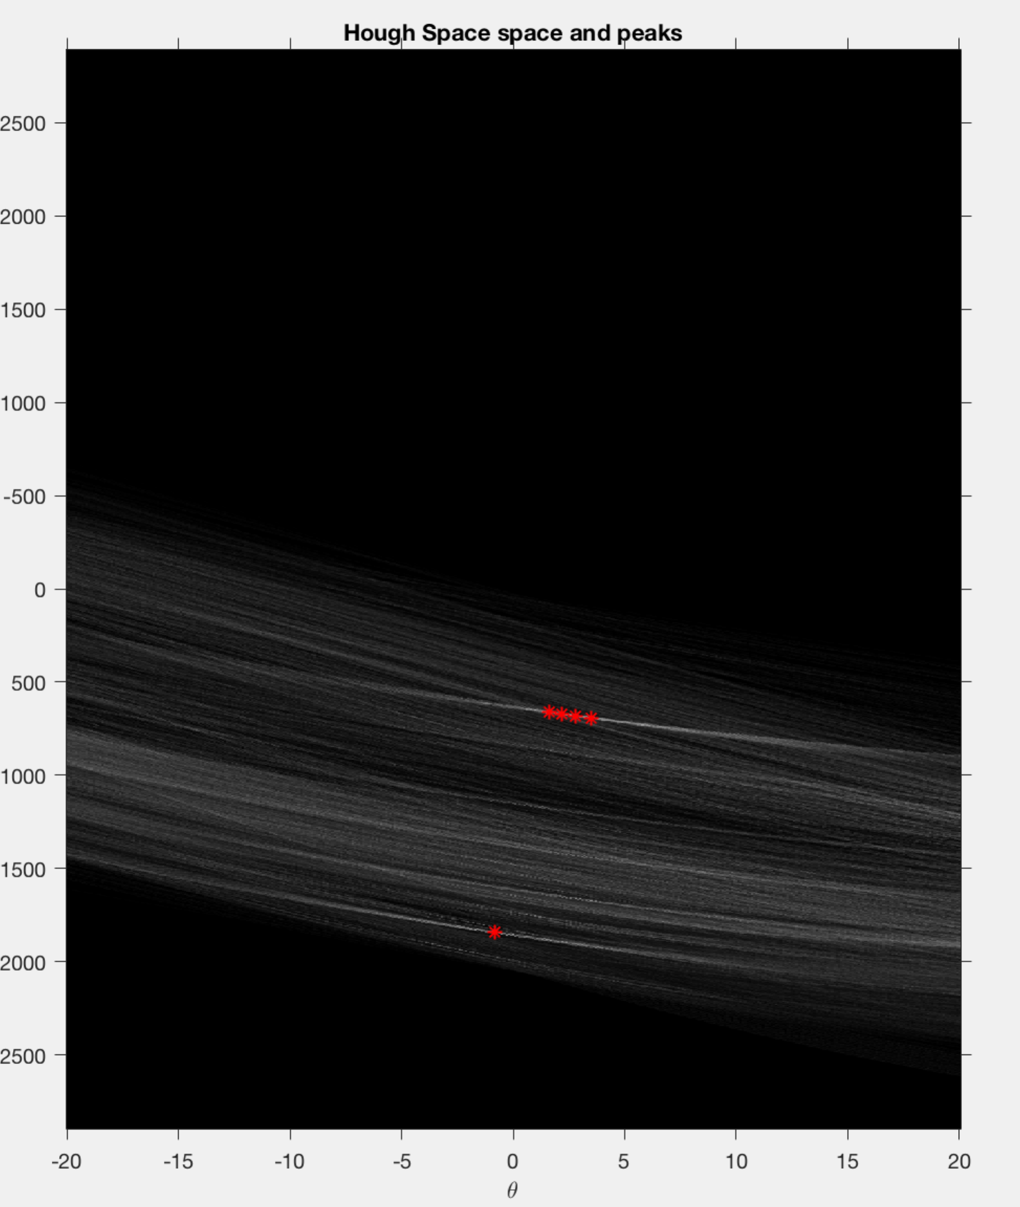
Result
Step2
Result

Slide 7
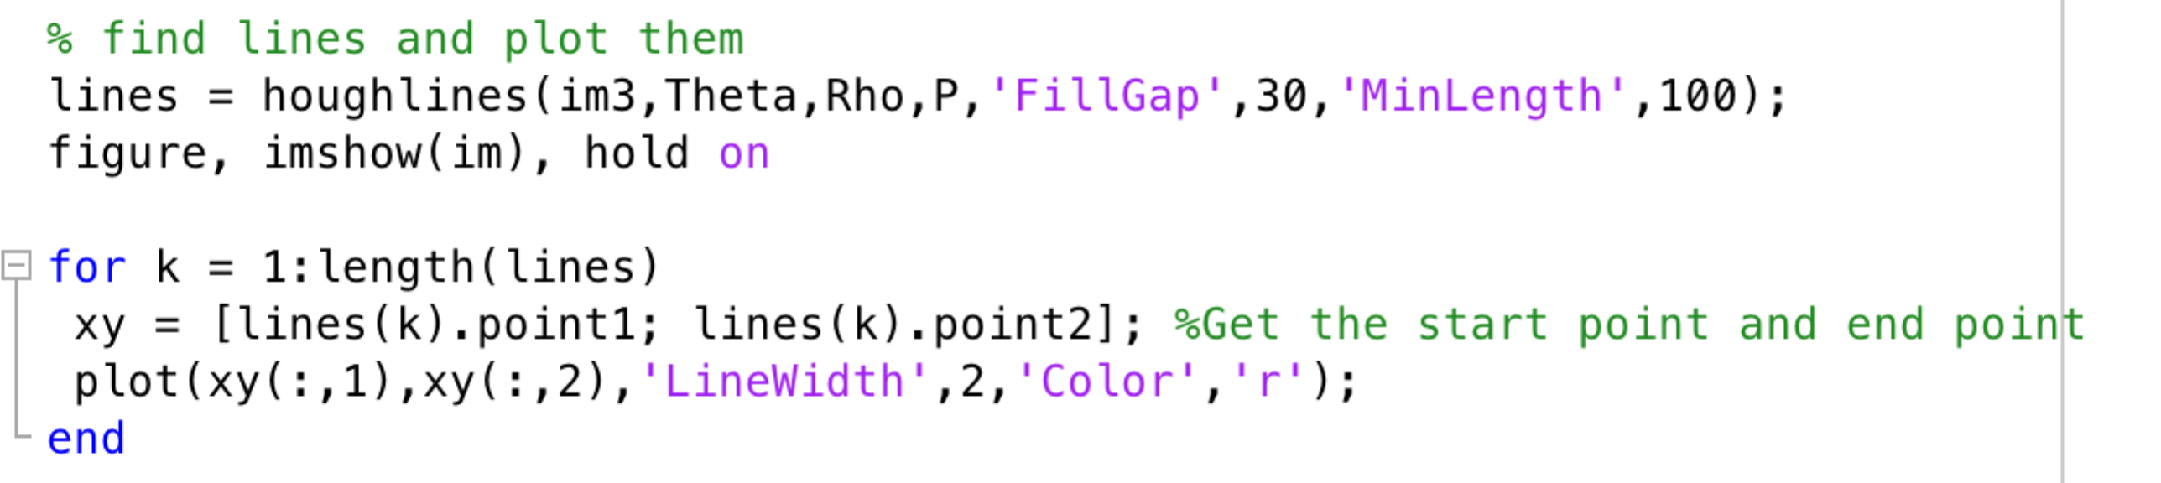
Approach
Step3
In this step,we can get lines from Houghlines then we plot them in original picture.

Slide 8
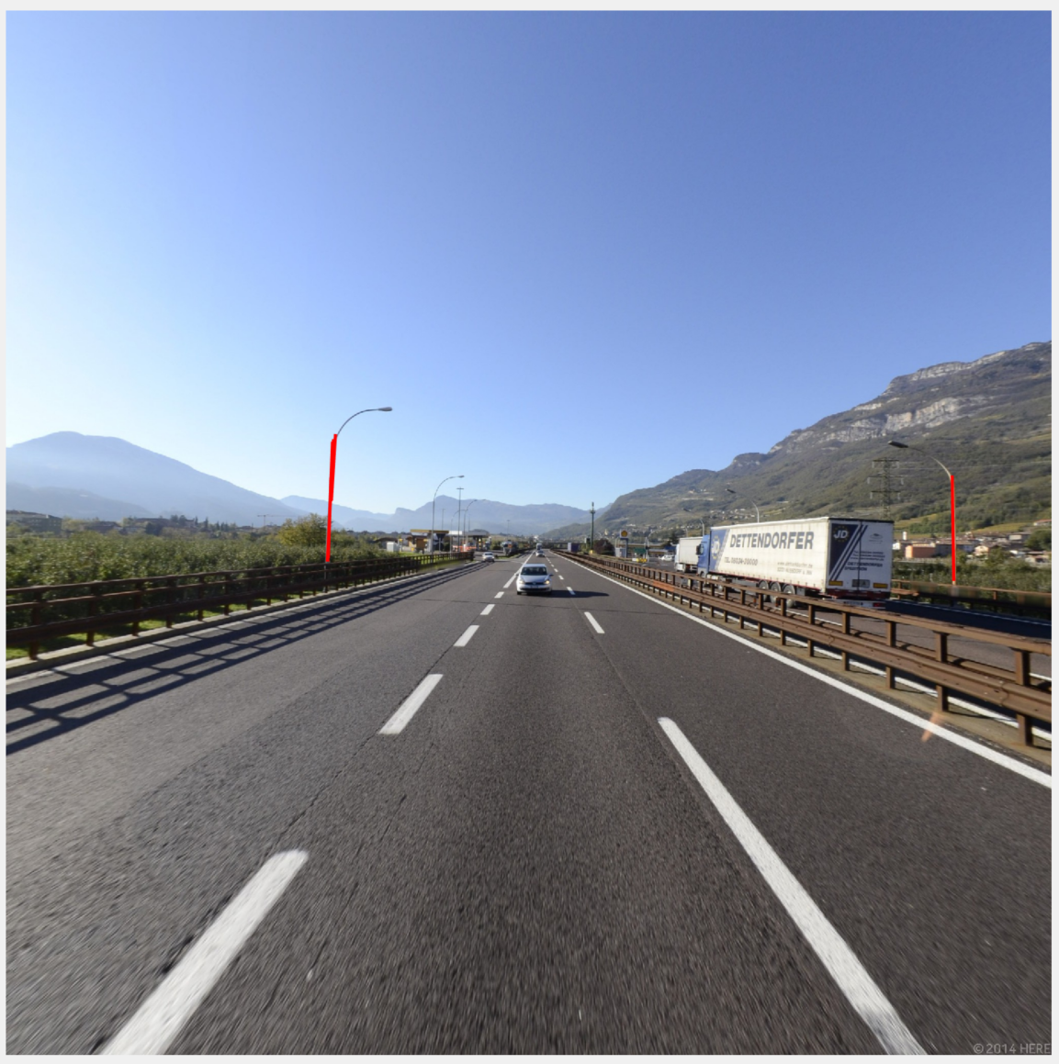
Result
Step3
Result
This picture shows the result of Back.jpg
image.

Slide 9
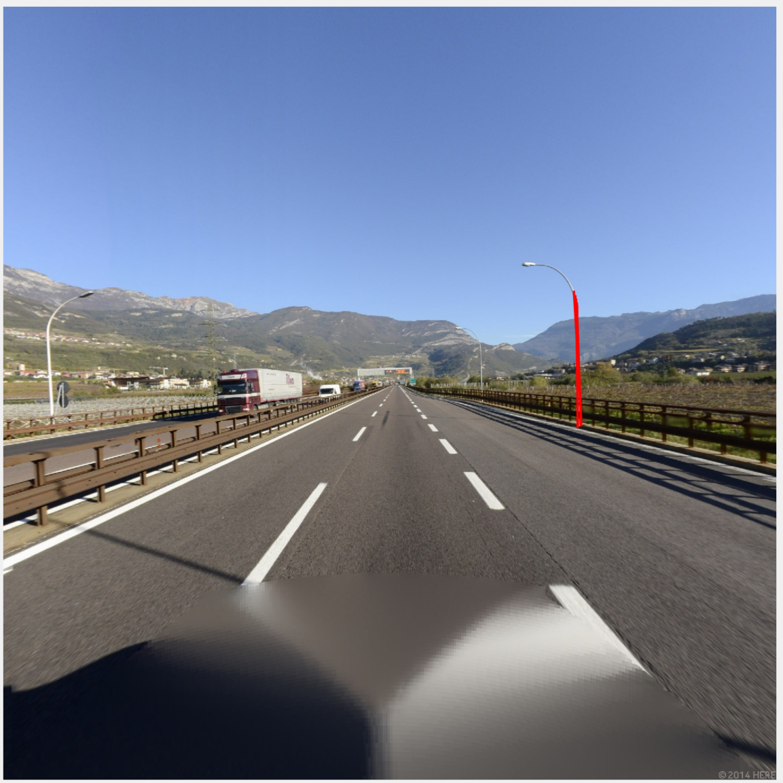
Result
Step3
This Step shows the reult of Front.jpg
image.

Slide 10
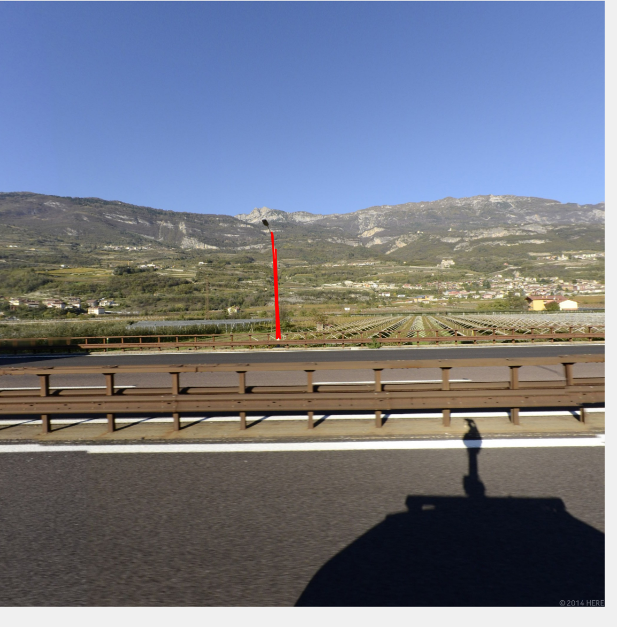
Result
Step3
This picture shows the result of Left.jpg image

Slide 11
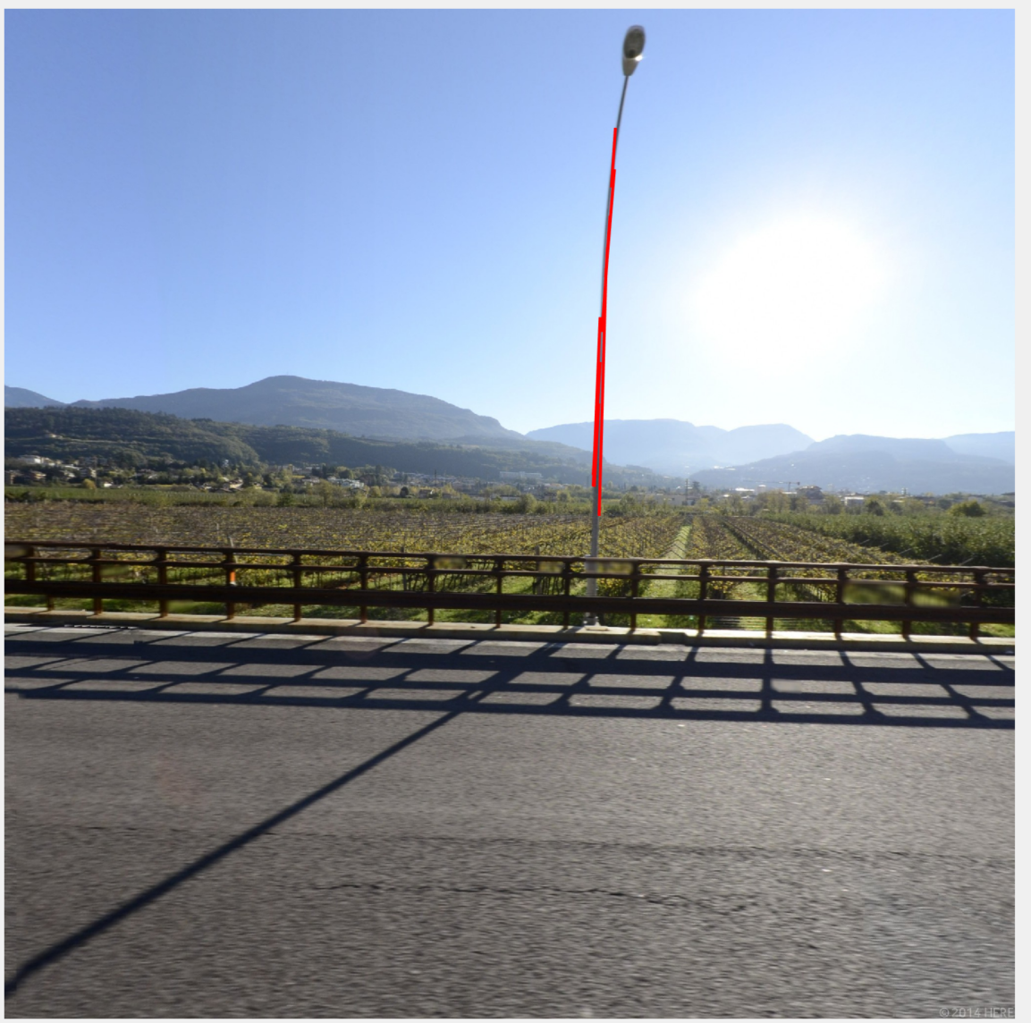
Result
Step3
This picture shows the result of Right.jpg
image

Slide 12
Pros and Cons
Pros:In preprocessing step1, if we can't remove all unnecessary objects and noise from images, the Hough Transform process may produce bad results.
Cons:To improve this program, we can divide each image into 3 parts: Left, Mid, Right. And our Pole Detection algorithm can focus on the needed part which can avoid the distortion by vehicles.

Slide 13
Another Approach
The following codes and images are the Old Approach's result we tried in this Pole Detection project. It uses Open and Close process to get the pole object. (The Old Approach means we finally abandoned it)

Slide 14
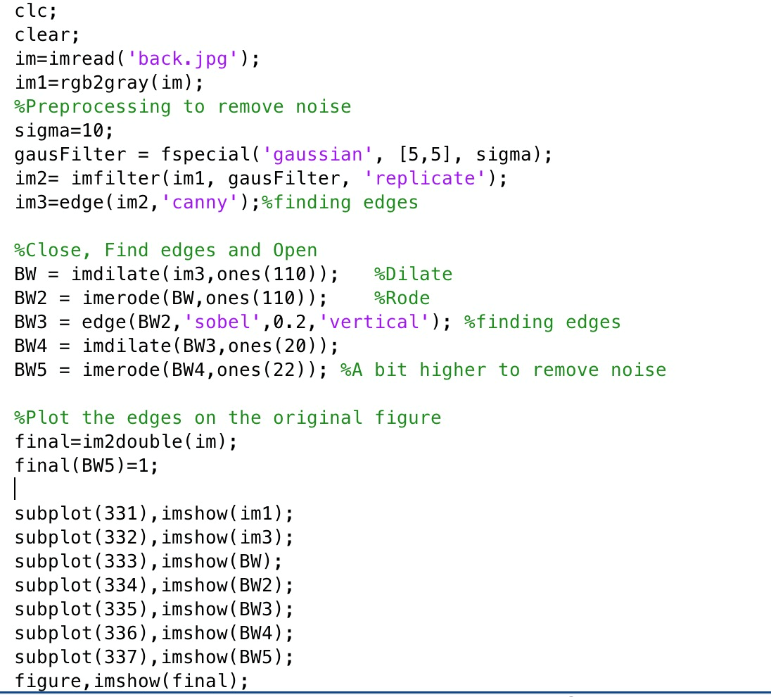
Source code of Old Approach

Slide 15
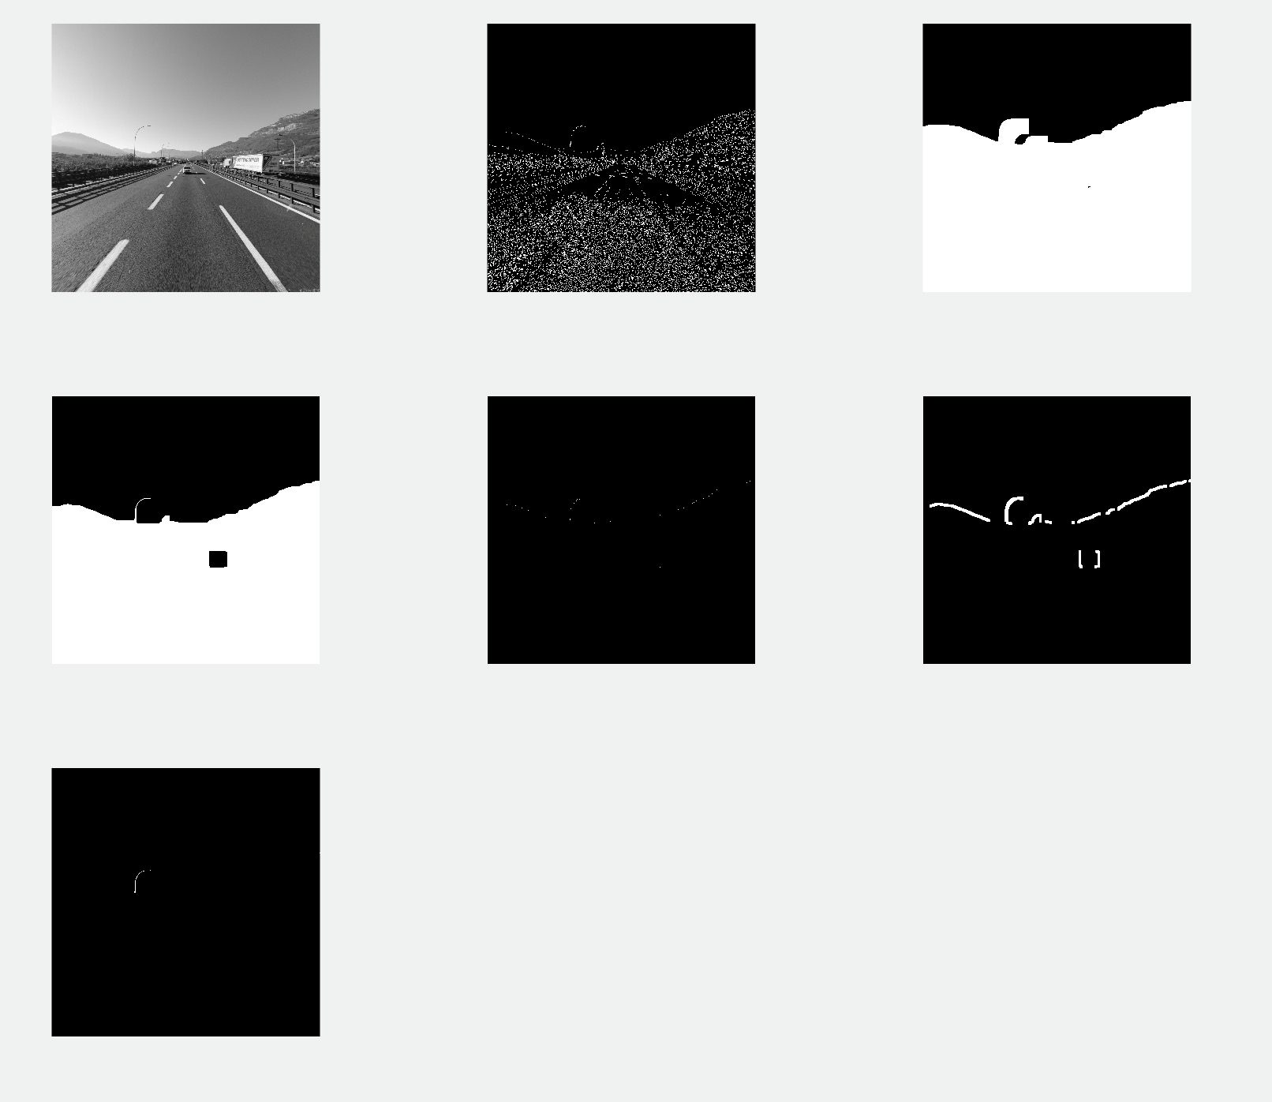
Result of Old Approach

Slide 16
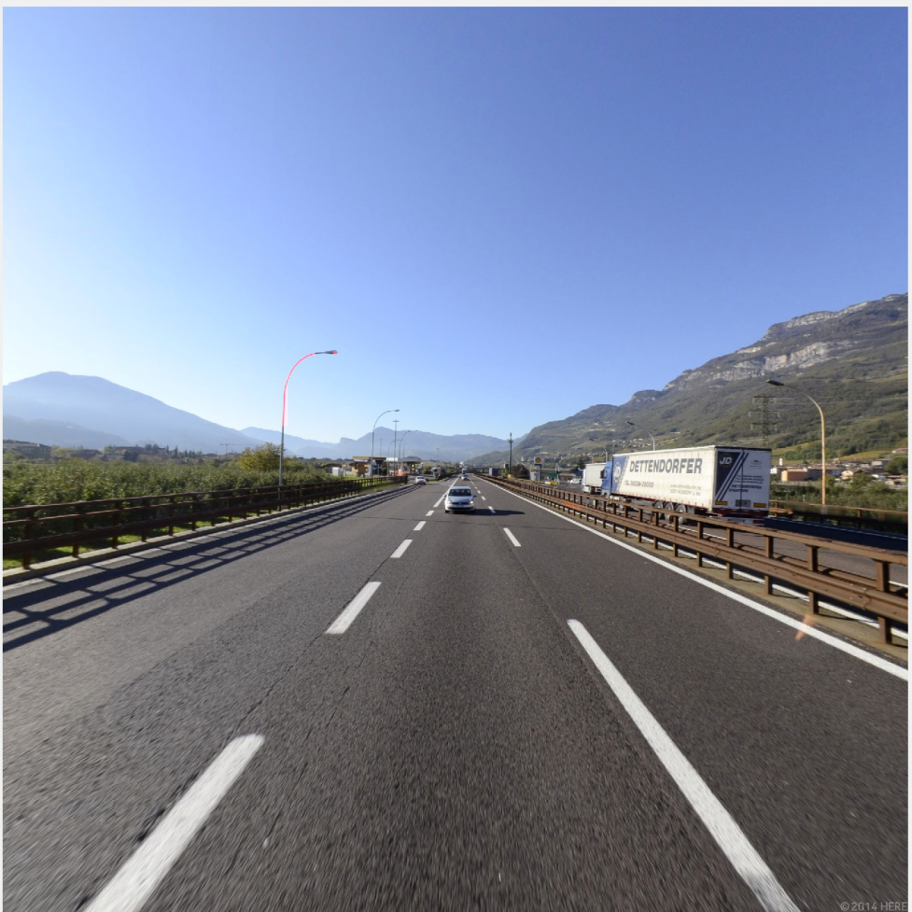
Result of Old Approach
This pole object on the left side is colored with red.

Slide 17
Why we choose Hough Transform?
The disadvantage of this Old Approach is its parameters of Open and Close process should be changed according to the image's background. That's why we choose the Hough Transform Algorithm instead!(see pages 1~12)

Slide 18
Thank you for watching!

